Slide 1
A Membership Service of
the Massachusetts
Municipal Association
MGFOA FALL MEETING
CYBER PROGRAM
October 17, 2018

Slide 2
MIIA Member Services
MIIA Cyber Program
Serving over 400 members
Annual premiums over $600M
Risk Management & Wellness Services
Health, Dental, Property, Liability & Workers’ Compensation
Insurance & Risk Management solutions for Members
October 17, 2018

Slide 3
MIIA Cyber Program
Cyber Risk Management - www.emiia.org
MIIA Cyber Coverages
Claim Scenarios
Claim Incident Resources
Questions
October 17, 2018

Slide 4
MIIA Cyber Program
DO YOU KNOW WHERE YOUR DATA HAS BEEN TODAY?
Causes of Data Breaches in 2017:
Hacking (includes skimming/phishing /malware/ransomware) 59.5%
Employee Negligence 10.4%
Accidental Exposure 6.4%
3rd Party Theft 7.5%
Insider Theft 5.3%
Physical Theft 4.5%
October 17, 2018

Slide 5
MIIA Cyber Program
TYPES OF BREACHES:
Employees & Social Media
Employee carelessness/negligence
Ransomware (i.e. CryptoLocker, etc.)
Rogue employees
Phishing Schemes
Lost/stolen devices
October 17, 2018

Slide 6
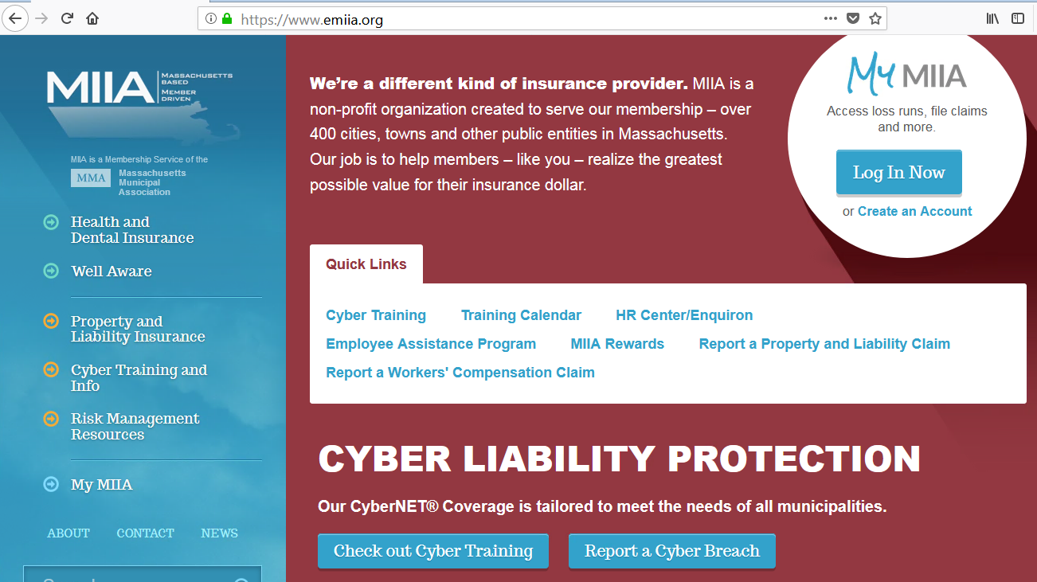
MIIA Cyber Program
Cyber Training
Courses
Guides
Webinars
Sample Policies
Data Security Policies
Plans
Procedures
Incident Response Plans
Best Practices
www.emiia.org
https://emiia.nascybernet.com/index.php
October 17, 2018

Slide 7
CyberNet

Slide 8
MIIA Cyber Program
MIIA Cyber Coverage - CyberNet
Property, Liability & Extra Expense
$1,000,000 Indemnity
$1,000,000 Defense
$100,000 Crime
Deductibles Various
Full Unknown Prior Acts Coverage Available
(Subject to Underwriting Review)
October 17, 2018

Slide 9
MIIA Cyber Program
COVERAGE FORM A-J
Multimedia Liability
Security and Privacy Liability
Privacy Regulatory Defense and Penalties
PCI DSS Liability
Breach Event Costs
BrandGuard®
Network Asset Protection
Cyber Extortion
Cyber Crime
Dependent System Failure
October 17, 2018

Slide 10
MIIA
CyberNet
October 17, 2018

Slide 11
MIIA Cyber Program
Coverage Descriptions
COVERAGE A: Multimedia Liability
Coverage for third party claims alleging liability resulting from the dissemination of online or offline media material, including claims alleging copyright/trademark infringement, libel/slander, plagiarism, or personal injury.
COVERAGE B: Security & Privacy Liability
Coverage for claims alleging liability resulting from a security breach or privacy breach, including claims alleging failure to safeguard personal information.
COVERAGE C: Privacy Regulatory Defense & Penalties
Coverage for regulatory fines and penalties and regulatory compensatory awards incurred in privacy regulatory proceedings/investigations brought by federal, state, or local governmental agencies.
COVERAGE D: PCI DSS Liability
Coverage for assessments, fines, or penalties imposed by banks or credit card companies due to non-compliance with the Payment Card Industry Data Security Standard (PCI DSS) or payment card company rules.
October 17, 2018

Slide 12
MIIA Cyber Program
Coverage Descriptions
COVERAGE E: Breach Event Costs
Coverage for mitigation costs and expenses incurred because of a privacy breach, security breach or adverse media report, including legal expenses, public relations expenses, IT forensic expenses, and costs to provide credit monitoring and identity theft assistance to affected individuals.
COVERAGE F: BrandGuard®
Coverage for loss of net profit incurred as a direct result of an adverse media report or notification to affected individuals following a security breach or privacy breach.
COVERAGE G: Network Asset Protection
Coverage for reasonable and necessary amounts incurred to recover and/or replace electronic data that is compromised, damaged, lost, erased or corrupted due to (1) accidental damage or destruction of electronic media or computer hardware, (2) administrative or operational mistakes in the handling of electronic data, or (3) computer crime/attacks including malicious code and denial of service attacks. Coverage also extends to business income loss and interruption expenses incurred because of a total or partial interruption of an insured computer system directly caused by any of the above events.
October 17, 2018

Slide 13
MIIA Cyber Program
Coverage Descriptions
COVERAGE H: Cyber Extortion
Coverage for extortion expenses incurred and extortion monies paid as a direct result of a credible cyber extortion threat.
COVERAGE I: Cyber Crime
Coverage for loss of money or securities incurred due to financial fraud, including wire transfer fraud; charges incurred for unauthorized calls resulting from fraudulent use of an Insured’s telephone system; expenses incurred to notify customers of phishing schemes that impersonate the Insured or the Insured’s brands, products or services, and the costs of reimbursing customers for loss they sustain as a result of such phishing schemes.
COVERAGE J: Dependent System Failure
Coverage for a business’ loss of income and interruption expenses incurred as a result of a third-party service provider‘s system going down.
October 17, 2018

Slide 14
MIIA Cyber Program
CLAIMS SCENARIOS
Security & Privacy Liability
A laptop belonging to the IT Director of a High School was stolen from the IT Director’s car while it was parked in the school’s parking lot. The laptop contained the personal information of students, including contact information and social security numbers. The IT Director did not take precautions to encrypt or otherwise protect the data on his laptop, which was a violation of the school’s privacy policy. The school reported the lost laptop to local law enforcement and notified the families of affected students. Several families filed a class action lawsuit against the school district for failure to safeguard the students’ private information. The school’s cyber insurance covered defense costs and damages awarded against the school.
October 17, 2018

Slide 15
MIIA Cyber Program
CLAIMS SCENARIOS
Breach Event Costs
An iPad issued to a town employee went missing. The iPad contained confidential records, including personally identifiable information (PII) of over 1,000 residents of the municipality. The Insured's cyber insurance reimbursed the Insured for the costs incurred to notify affected residents of the breach and for costs associated with 12 months of credit monitoring.
October 17, 2018

Slide 16
MIIA Cyber Program
CLAIMS SCENARIOS
Cyber Crime
An accountant in a Town received an e-mail from a member of the Town’s finance committee requesting a wire transfer be processed in the amount of $50,000. The wire was sent, but, in a later conversation with the head of the finance committee, the accountant discovered that the committee had not actually requested the wire transfer. In fact, the e-mail the accountant received was a “spoof” e-mail, sent by a hacker who had created a fraudulent e-mail account to impersonate a finance committee member. The bank would not return the Town’s funds because the transfer appeared to be legitimate. The Town was reimbursed for the financial loss under Cyber Crime insurance.
October 17, 2018

Slide 17
MIIA Cyber Program
MIIA CyberNet Claims Expertise
2400 Cyber Claims
50+ IT & Legal
20 In-house claims team
24/7 Cyber Hotline
800-526-6442
miiaclaims@mma.org
October 17, 2018

Slide 18
Questions?
Thank you for supporting the
MIIA Programs!
October 17, 2018

