Slide 1
ClearGov Budgeting Platform
Sean O’Brien Town of Barnstable Treasurer/Collector

Slide 2
Budgeting Approaches
Excel Word Based
Powerpoint
Munis (central budget entry / purely GL focused)
ClearGov

Slide 3
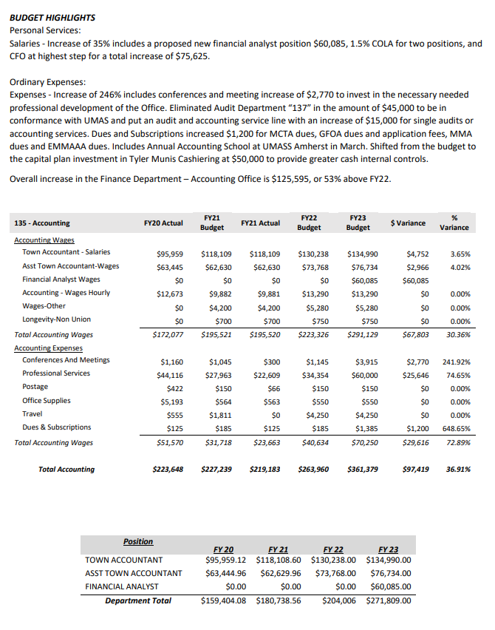
Examples Excel / Word Based
GL exports for prior years
Department Involvement in narrative & performance measures
Internal links & data intensive

Slide 4
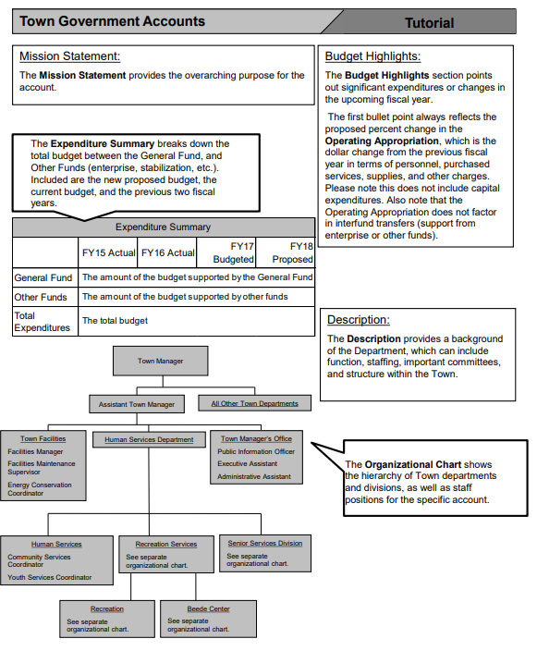
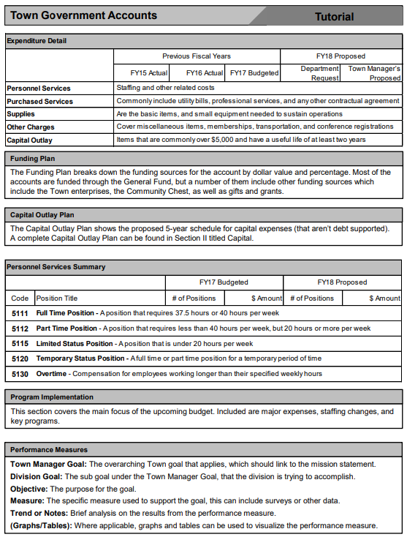
Powerpoint
Challenging for initial implementation

Slide 5
ClearGov
Digital Budget Book
Implementation – 2018 approx. 2 months
GL download & appropriation groupings
Departments have access to only their accounts (prior historical information is saved)
Departments put in line item requests on platform w/ justification & attachments

Slide 6
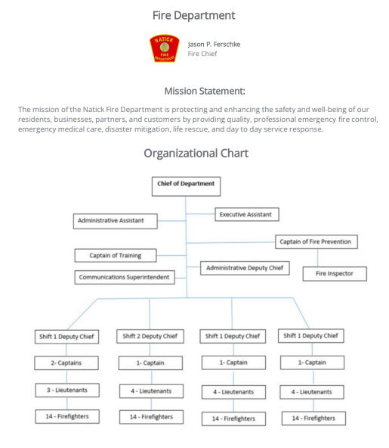
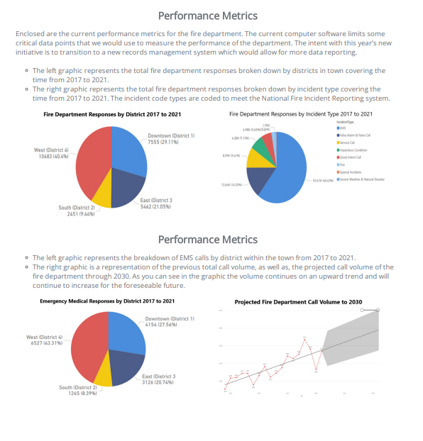
Sample ClearGov Budget Pages

Slide 7
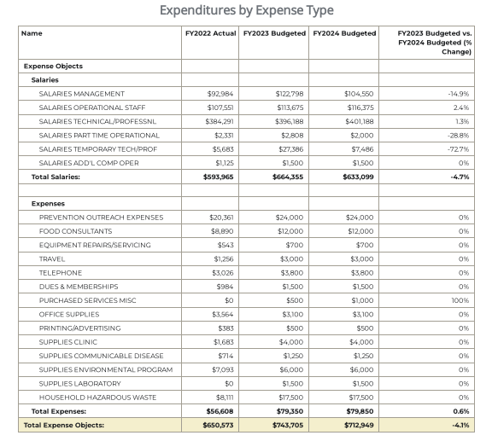
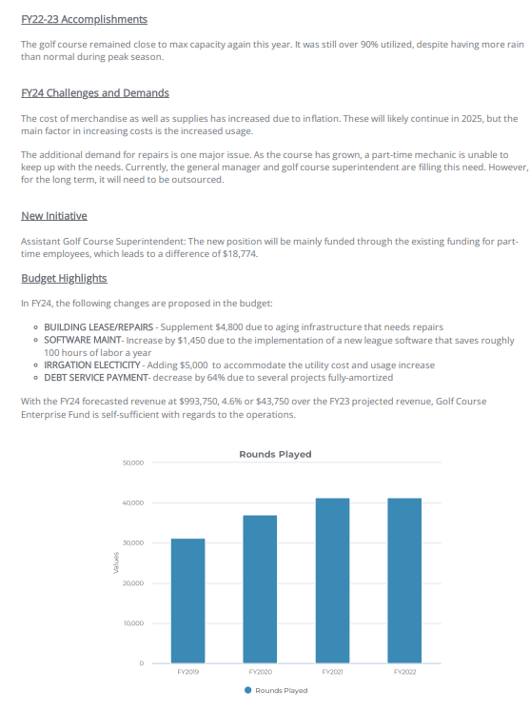
Sample ClearGov Budget Pages

Slide 8
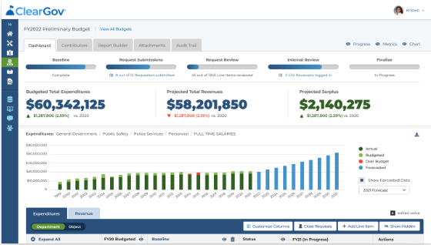
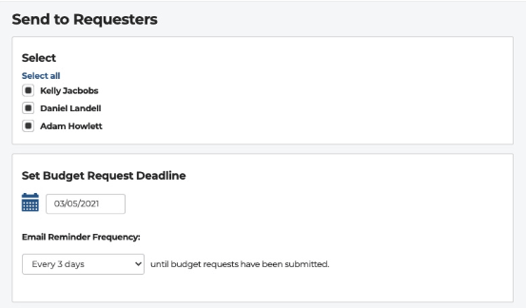
ClearGov Dashboard

