Slide 1
Form 1099 Reporting
Presented by Emily Miner, Accounting Services Marcum LLP
Notes:
Good afternoon and thank you all for joining me today. My name is Emily Miner and I am a paraprofessional in accounting services at the Marcum Providence office. I have been with the firm for 5 years. As many of you know, Marcum is one of the largest public accounting firms in the country with offices all over the world.

Slide 2
What is a 1099 ?
“Form 1099 is used to report certain types of non-employment income to the IRS, such as dividends from a stock or pay you received as an independent contractor. Businesses must issue 1099s to any payee (other than a corporation) who receives at least $600 in non-employment income during the year”.
Notes:
The IRS reports there are nearly two dozen different types of 1099s. The more common 1099’s are the NEC, MISC, R, INT,& K. For today’s discussion I am going to focus on the 1099 NEC and the 1099 MISC. If you have specific questions about other 1099 forms, please feel free to reach out to me personally via email. I will provide my information at the end of the presentation.

Slide 3
Who Receives a 1099 ?
For forms 1099 NEC and MISC, the requirements are different. In the next slides we will go over what the specific requirements are per the IRS website.
One of the more common misconceptions about recipients is the LLC.
An LLC is required to receive a 1099. The exception to this rule is if the LLC is an S-Corp or C-Corp. If the LLC is designated as S or C-Corp, they are not required to receive a 1099.
The best way to start your 1099 process is to get a signed W-9 from all your vendors. In box 3 of the W-9, it asks the federal entity type, which will make it easy for you to determine if filing is required. By implementing this into your accounting tasks, you are saving time and streamlining your processes for yearly 1099 generation.
If you are still unsure, reach out to me or your favorite Marcum tax expert for advice.

Slide 4
1099-MISC, Miscellaneous Information
File Form 1099-MISC for each person to whom you have paid during the year:
At least $10 in royalties or broker payments in lieu of dividends or tax-exempt interest.
At least $600 in:
Rents.
Prizes and awards.
Other income payments.
Medical and health care payments.
Crop insurance proceeds.
Cash payments for fish (or other aquatic life) you purchase from anyone engaged in the trade or business of catching fish.
Generally, the cash paid from a notional principal contract to an individual, partnership, or estate.
Payments to an attorney (see payments to attorneys, later.)
Any fishing boat proceeds.
In addition, use Form 1099-MISC to report that you made direct sales of at least $5,000 of consumer products to a buyer for resale anywhere other than a permanent retail establishment.
(IRS, 2024)

Slide 5
1099-NEC, Nonemployee Compensation
File Form 1099-NEC for each person to whom you have paid during the year:
At least $600 in:
Services performed by someone who is not your employee (including parts and materials) (box 1); or
Payments to an attorney (box 1). (See payment to attorneys, later.)
File Form 1099-NEC or Form 1099-MISC to report sales totaling $5,000 or more of consumer products to a person on a buy-sell, a deposit-commission, or other commission basis for resale.
Instructions for Forms 1099-MISC and 1099-NEC (01/2024) can be found on the IRS website at : https://www.irs.gov/instructions/i1099mec
(IRS,2024)

Slide 6
Payments to Attorneys
Gross proceeds paid to attorneys.
Are made to an attorney in the course of your trade or business in connection with legal services, but not for the attorney’s services, for example, as in a settlement agreement;
Total $600 or more; and
Are not reportable by you in box 1 of Form 1099-NEC. Under section 6045(f), report in box 10 of the 1099-MISC.
Box 10 1099-MISC -- Gross Proceeds Paid to an Attorney
Enter gross proceeds of $600 or more paid to an attorney in connection with legal services (regardless of whether the services are performed for the payer).
Box 1 1099-NEC – Legal Services
The term “attorney” includes a law firm or other provider of legal services. Attorneys' fees of $600 or more paid in the course of your trade or business are reportable in box 1 of Form 1099-NEC, under section 6041A(a)(1).
Payments to corporations for legal services are required for both NEC & MISC
The exemption from reporting payments made to corporations does not apply to payments for legal services. Therefore, you must report attorneys' fees (in box 1 of Form 1099-NEC) or gross proceeds (in box 10 of Form 1099-MISC) as described earlier to corporations that provide legal services.
(IRS, 2024)

Slide 7
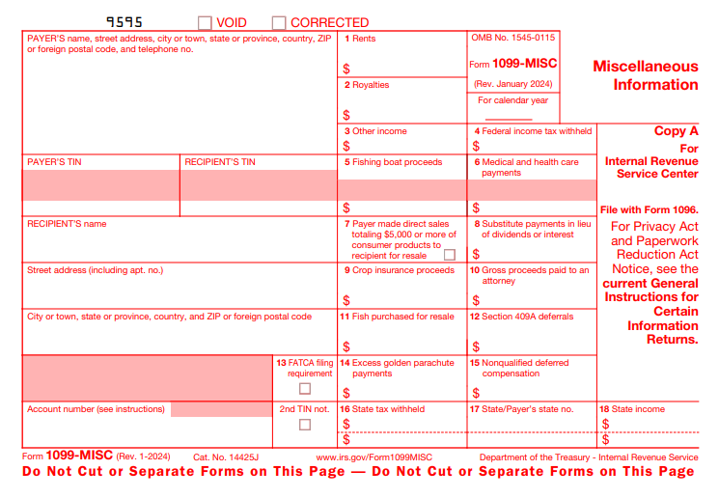
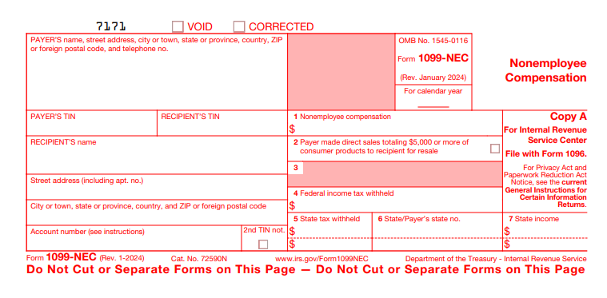
Sample 1099 Forms
1099-MISC
Due to recipient January 31st
Due to IRS February 28th if filing on paper, due March 31st if filing electronically
1099-NEC
Due to recipient January 31st
Due to IRS January 31st (both paper and electronic)
(IRS, 2024)

Slide 8
Common Questions
Filing, state requirements

Slide 9
How Do I File a 1099 ?
Filing Directly with the IRS
10 or more returns: E-filing now required
Starting tax year 2023, if you have 10 or more information returns, you must file them electronically. This includes Forms W-2, e-filed with the Social Security Administration. Find details on the final e-file regulations and requirements for Forms W-2.
To e-file, apply now for a Transmitter Control Code (TCC). It may take up to 45 days for processing.
E-file with software through IRIS Application to Application (A2A)
If you have a third-party software or service or are developing software, you can use IRIS A2A to e-file thousands of returns (up to 100 MB at a time).
E-file through the IRIS Taxpayer Portal
This free, web-based filing system lets you:
E-file up to 100 returns at a time
Enter manually or by .csv upload
Download payee copies to distribute
Keep a record of completed, filed and distributed forms
Save and manage issuer information
Get started
To use the IRIS Taxpayer Portal, you need an IRIS Transmitter Control Code (TCC). This 5-digit code identifies your business when you e-file forms. It can only be used for IRIS.
Apply for an IRIS Taxpayer Portal TCC
The link to this information is : https://www.irs.gov/filing/e-file-forms-1099-with-iris
(IRS, 2024)

Slide 10
How Do I File a 1099 ? (cont’d)
Most accounting software offers integration within the system to generate and file1099’s for you.
There are many 1099 software programs available to use at a reasonable cost.
Using a software program can simplify the process and save time, versus manual upload to the IRIS Taxpayer Portal and uploading to each recipient's state portal.
My preference is to use software to prepare and file the 1099’s for me. Marcum offers
a 1099 prep software program to all its clients so that they may generate and file 1099’s on their
own, if they choose. We also offer 1099 prep services in house, which is how I have become so knowledgeable with the process.
Personally, I favor a program called Track1099. It is very user friendly and will also do all the state
Filings for you. Cost is fair, they offer address verification and TIN matching services as well.
If anyone is interested in a 1099 software demo, I would be happy to come back and share that with you.

Slide 11
What are the state requirements for 1099’s ?
Which states do not require 1099 filing?
If you are in Alaska, Florida, Illinois, New Hampshire, Nevada, New York, South Dakota, Tennessee, Texas, Washington, or Wyoming. You're not required to file Forms 1099-NEC and 1099-MISC with your state.
Each state has its own requirements for 1099 uploading, formats, and due dates.
Track 1099 offers a free tool to see if a state filing is required. It also provides a lot of extra information regarding uploading, supported states, and additional filing requirements.
Please see : https://www.track1099.com/info/state_info

Slide 12
Other Helpful Information
PAYMENTS TO RECIPIENTS THAT ARE MADE VIA CREDIT CARD, DEBIT CARD, OR THIRD-PARTY SYSTEM SUCH AS PAYPAL DO NOT GET REPORTED ON A 1099 FORM. THE FINANCIAL INSTITUTION IS RESPONSIBLE TO REPORT ON FORM 1099-K (IF REQUIRED).
FOR 1099-R REPORTING, ALWAYS DEFER TO YOUR TPA FOR GUIDANCE ON WHICH BOXES TO CHOOSE FOR THE RECIPIENT. IF NOT AVAILABLE, REACH OUT TO YOUR TAX EXPERT FOR ADDITIONAL ADVICE, AS EACH SITUATION IS UNIQUE.
PENALTIES FOR EACH INFORMATION RETURN FILED LATE FOR 2023 :
$50 -- UP TO 30 DAYS LATE
$110 -- 31 DAYS LATE THROUGH AUGUST 1
$290 -- AFTER AUG 1 OR NOT FILED
$580 -- INTENTIONAL DISREGARD
(IRS, 2024)
Notes:
I have yet to see any penalties come through for clients who file late 1099s. But as you can see, it is still a possibility. What I do see is notices and penalties for incorrect TINS. Obtaining a signed W-9 and or using a TIN matching service with a 1099 prep provider is your best safeguard for this type of situation.

Slide 13
Thank You for your time today ! Please feel free to email me with any questions : emily.miner@marcumllp.com
Notes:
Thank you so much everyone for your time today. I hope you all have a wonderful week!

Slide 14
References : IRS, 2024. Track1099, 2024.

